Slide 2
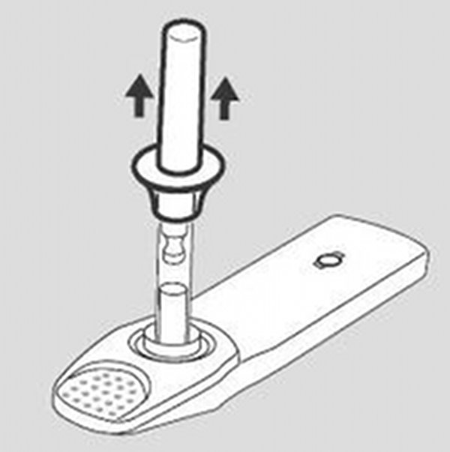
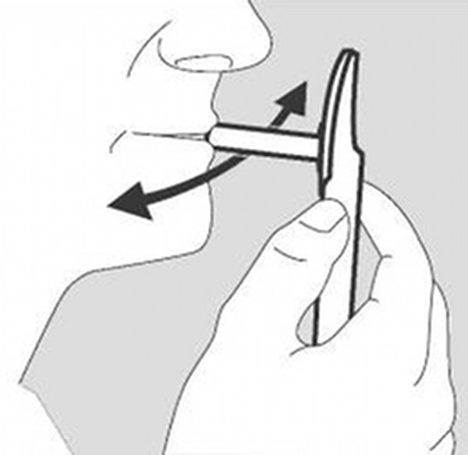
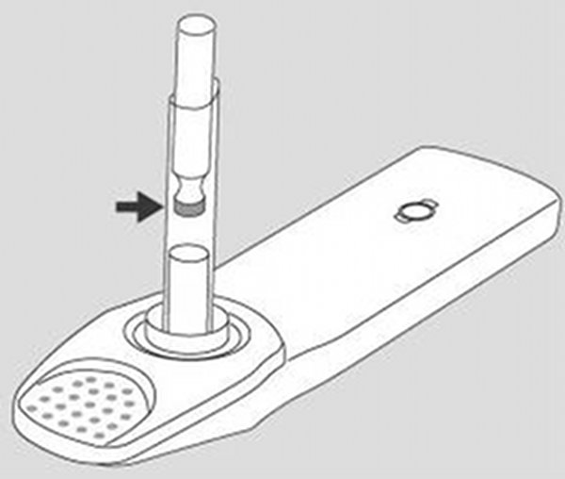
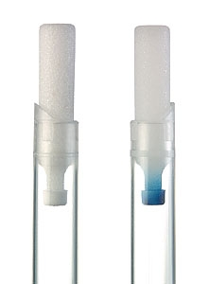
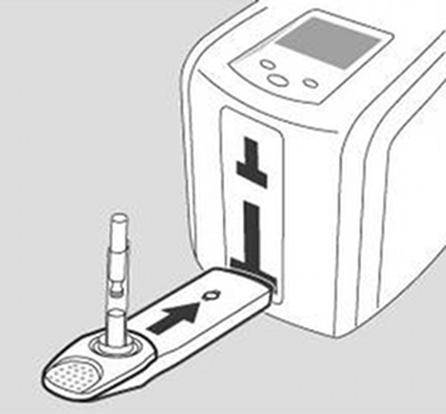
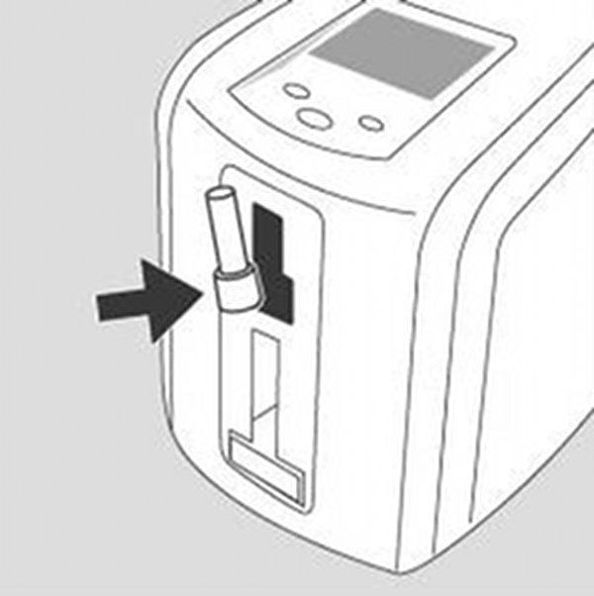
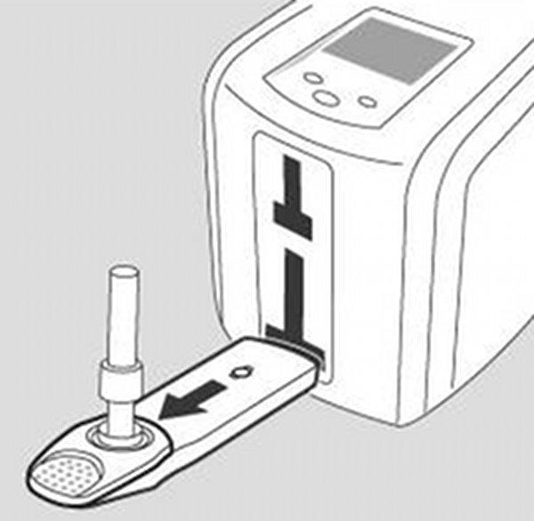
Testing
Performing a Test
1.
2.
Remove protective cap
Move collector in mouth swabbing gums and cheeks on both sides
Sample collection is finished when indicator turns blue
3.
4.
5.
Insert cassette into analyser
“Click In” buffer cartridge and close flap → Start
Remove test kit after measurement is complete

